Slide 1
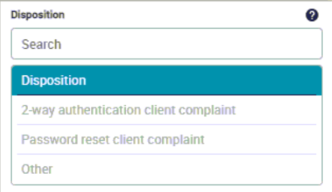


IC Dispositions
Once a call ends, the below dispositions will display:
  2-way authentication client complaint
    Select if client made negative remarks about the new 2-way authentication process
  Password reset client complaint
    Select if client made negative remarks about the new password reset requirements
  Other
    Select if there were no complaints
  Once Selection is made, select Save & Close
Once a disposition is selected, you will be placed in available status for the next call.
If 5 seconds pass with no action, you will be placed in available status for the next call and no response will be recorded.
Confidential

